Slide 1
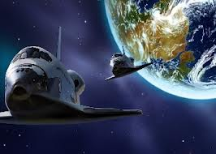
Space Exploration

Slide 2
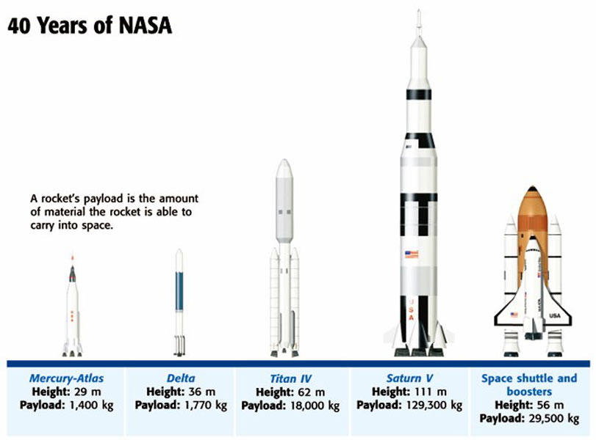
NASA-National Aeronautics and Space Administration formed in 1958

Slide 3
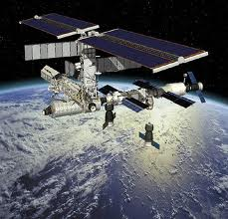
Rocket- a machine that uses escaping gas from burning fuel to move
Artificial Satellite - any human made object placed in orbit around a body in space.
Artificial satellites have changed the way we live
Military satellites
Weather satellites
Communication satellites
Remote Sensing- the gathering of images and data from a distance

Slide 4
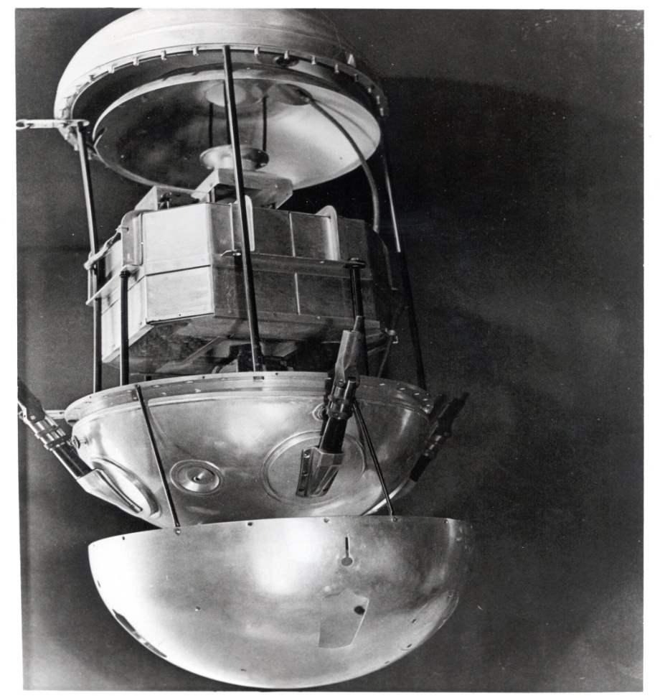
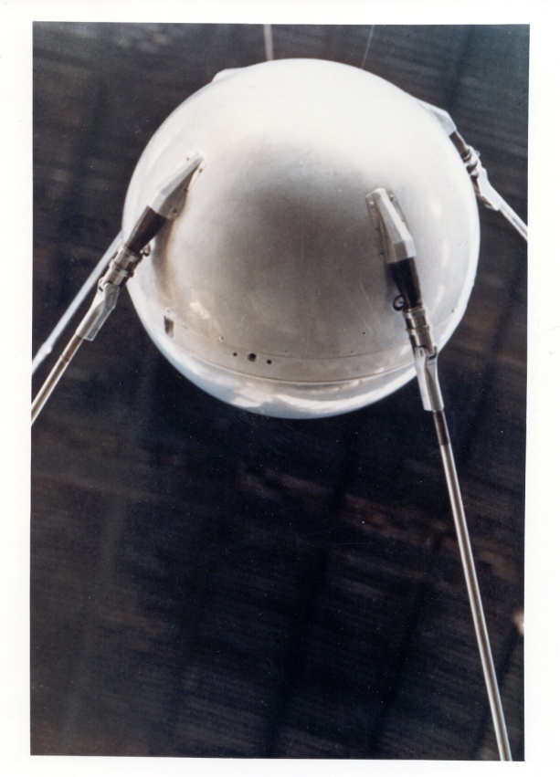
http://history.nasa.gov/sputnik/gallerysput.html
Sputnik 1- first artificial satellite launched by the Soviets (Russia) in 1957.
Orbited Earth for 57 days before it burned up in Earth’s atmosphere
Sputnik 1
http://www.youtube.com/watch?v=TbAXkWPasYw
Sputnik 1, exploded view

Slide 5
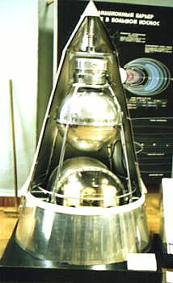
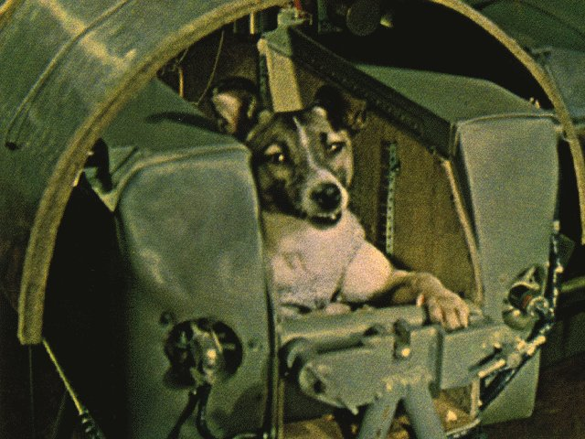
http://nssdc.gsfc.nasa.gov/nmc/spacecraftDisplay.do?id=1957-002A
Sputnik 2 – carried the first living being into space-a dog name Laika in November
http://www.youtube.com/watch?v=Pz63twfoW3c

Slide 6
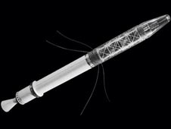
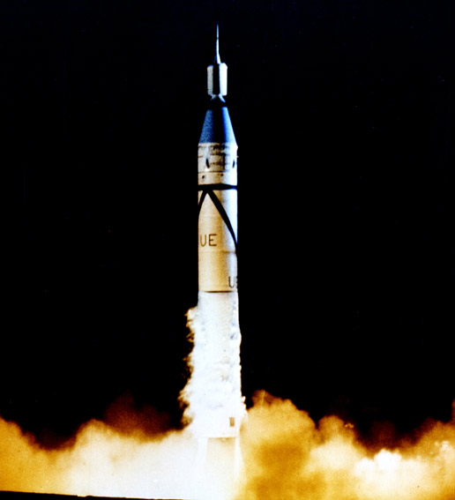
http://www.jpl.nasa.gov/explorer/captions/launch.php
Explorer 1 –first satellite by USA in 1958
Explorer 1 Animation
http://www.jpl.nasa.gov/explorer/videos/explore1-anim-2.php

Slide 7
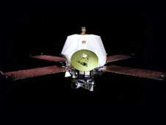
http://www.nasa.gov/centers/jpl/education/spaceprobe-20100225.html
Space Probe- uncrewed vehicle that carries scientific instruments to planets or other bodies in space
Space Shuttle- a reusable space vehicle that takes off like a rocket and lands like an airplane
Space Station- a long term orbiting platform in space
Mariner 9, the first probe to orbit Mars

Slide 8
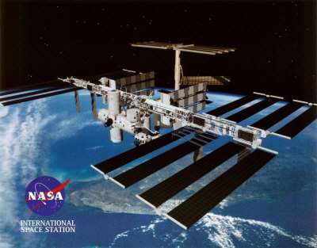
Space Shuttle
http://www.nasa.gov/mission_pages/shuttle/multimedia/index.html
Space Station
http://www.thetechherald.com/articles/Atlantis-successfully-docks-with-International-Space-Station

Slide 9
Yuri Gagarin became the first human to orbit the Earth (Soviet Union-April 12, 1961)
John Glenn became the first American to orbit the Earth (February 1962)
Neil Armstrong became the first human to step foot on the moon (July 20, 1969)

Slide 10
Benefits of Space Exploration
When exploring space, scientists not only learn more about space itself but also gain a large amount of knowledge by developing the missions to space
Cordless power tools
Pacemakers
Ear thermometers
Heat resistant suits
Helmets
Smoke detectors
Microwaves
GPS
Cell phones

Slide 11
http://www.nasa.gov/multimedia/videogallery/index.html
Red Solar Ballet
Left side of Sun
How did Mars Lose its Atmosphere?
River Fans on Earth and Mars
Space Shuttle: Endeavor
http://www.nasa.gov/multimedia/imagegallery/iotd.html

