Slide 1
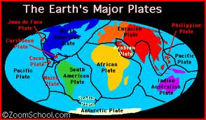
Plate Tectonics

Slide 2
A Guide to Taking Cornell Notes
Left side is smaller than the right side
Red words go on the left (vocab words)
Black words go on the right (definitions/explanations)
Purple words do not need to be written down

Slide 3
Tectonic Plates
Pieces of the lithosphere that move around on top of the asthenosphere
Fit together like a jigsaw puzzle
Move a few centimeters each year
Plates float on the asthenosphere like ice in water
Global Positioning Systems (GPS) are used to prove plate movement

Slide 4
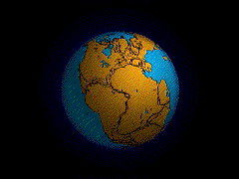
Continental Drift
The hypothesis that states that the continents once formed a single landmass, broke up and drifted to their present locations
Discovered by Alfred Wegnener

Slide 5
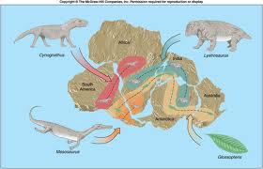
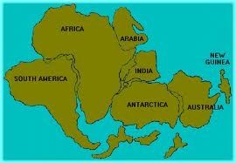
Evidence of Continental Drift
Continents fit together (South America and Africa)
Fossils of plants and animals were found on different continents
http://www.youtube.com/watch?v=Np9ADpKnBSY

Slide 6
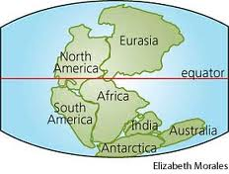
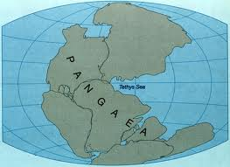
Pangaea
Continents joined as a single landmass
Means “all Earth” or “all Land”

Slide 7
Sea-Floor Spreading
The process by which new oceanic lithosphere forms as magma rises toward the surface and solidifies (becomes hard)
As tectonic plates move away from each other, the sea floor spreads apart and magma fills in the gap
http://www.youtube.com/watch?v=2urcZdH9e4U

Slide 8
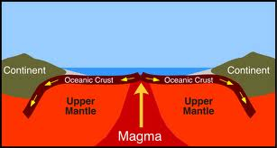
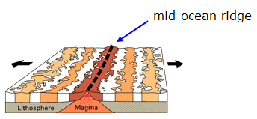

Slide 9
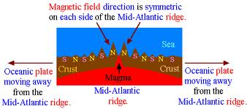
Magnetic Reversal
When earth’s magnetic poles change places
Proven by the magnetic reversals on the ocean floor

Slide 10
Plate Boundary
A place where tectonic plates touch
Three Boundaries
Convergent Divergent Transform
Two Tectonic plates collide
Continental-Continental
(two continental crust collide)
Continental-Oceanic (continental and oceanic crust collide)
Oceanic-Oceanic
(two oceanic crust collide)
Two tectonic plates separate
Two tectonic plates slide past each other horizontally

Slide 11
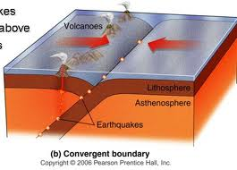
Convergent Boundary

Slide 12
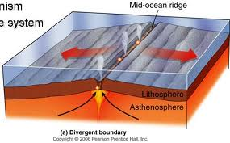
Divergent Boundary

Slide 13
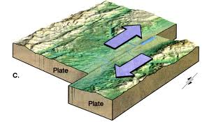
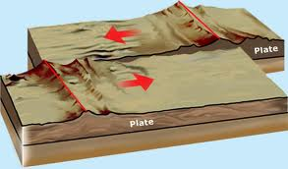
Transform Boundary

Slide 14
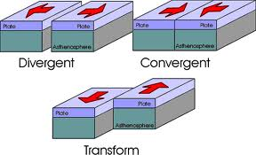

Slide 15
Sea Floor Spreading
http://www.youtube.com/watch?v=BHZM3CPFo_k
Pangaea
http://www.youtube.com/watch?v=gyT8Xs6Ab-k

Slide 16
Plate Tectonics Foldable
Sea-Floor Spreading
Convergent Boundary
Divergent Boundary
Transform Boundary
Must Include:
Pangaea put in order on the back (from what Pangaea looked like to the present continents
Each Vocab Word
Definition behind the vocab word
Detailed Picture on the inside
Textbook Help:
Pangaea (104/105)
Sea-Floor Spreading (106)
Boundaries (108/109)
**Index is a great resource**

Slide 17
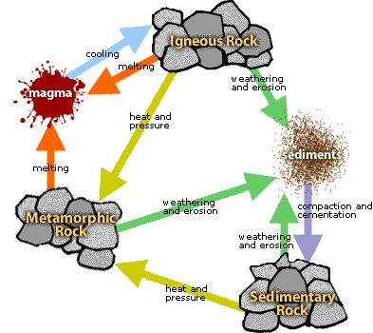
Rock Cycle

Slide 18
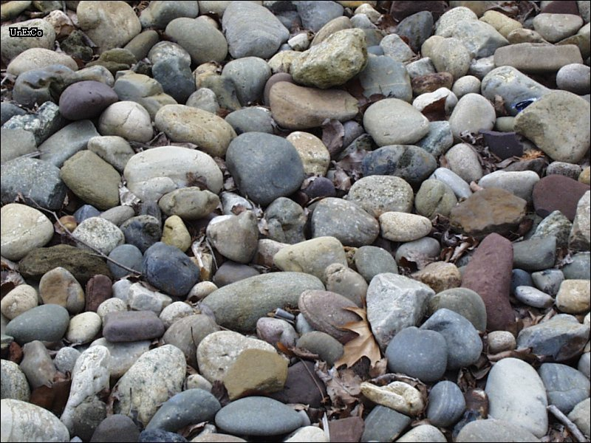
Rock
Solid mixture of crystals of one or more minerals

Slide 19
Value of Rocks
Natural resource
Used as tools and weapons
Used in buildings, roads and monuments
Used to answer questions about the history of earth and the solar system

Slide 20
Rock Cycle
The continual process by which new rock forms from old rock

Slide 21
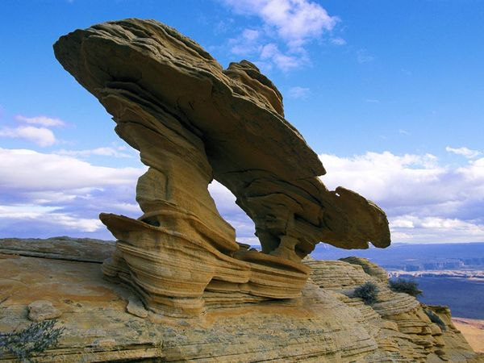
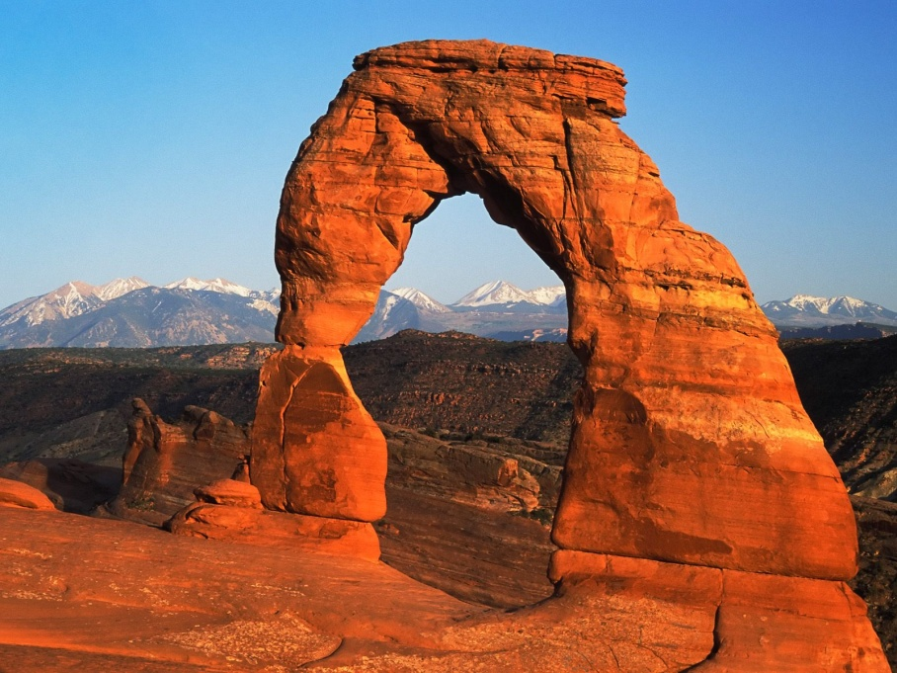
Weathering
The process in which water, wind, ice and heat break down rock

Slide 22
Sediment
Broken rock fragments (dirt/sand)

Slide 23
Erosion
Sediment is transported by wind, water, ice, or gravity

Slide 24
Deposition
Sediments settle to the bottom

Slide 25
Compaction
Layers form on top of each other
Air and water pushed out

Slide 26
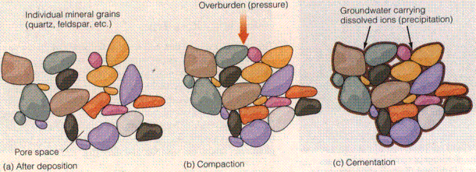
Cementation
Loose sediments are glued together by natural glue

Slide 27
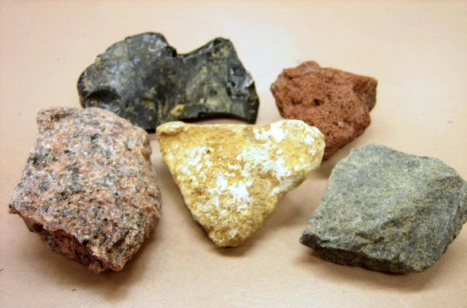
Igneous Rock
Magma in Earth’s crust that has risen to the surface, cooled and solidified

Slide 28
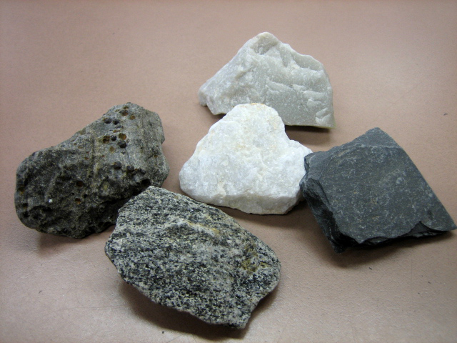
Metamorphic Rock
Rock is changed by heat and pressure

Slide 29
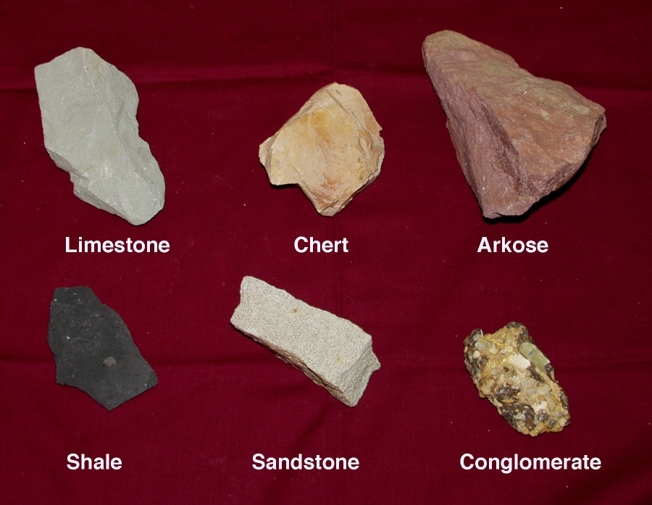
Sedimentary Rock
Natural resource
Used as tools and weapons
Used in buildings, roads and monuments

Slide 30
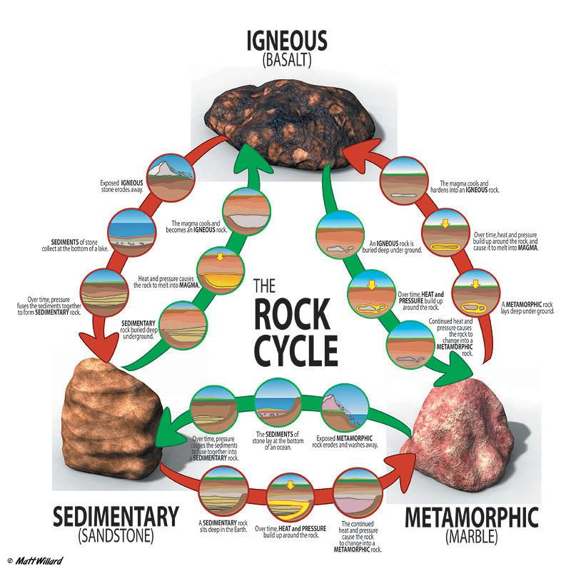

Slide 31
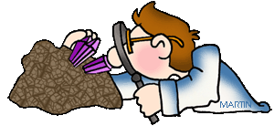
Rocks and Soil

Slide 32
Soil Importance
Provides minerals and other nutrients for plants
All animals get energy from plants

Slide 33
Soil Damage
Poor farming techniques or by over grazing
Overused soil can loose nutrients and become infertile

Slide 34
Conservation and Stewardship
The careful use and preservation of Earth’s natural resources
Reduce, reuse, recycle

Slide 35
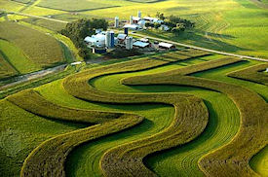
Contour Plowing
Growing crops up and down hill
Rain flows down the gaps in the crops

Slide 36
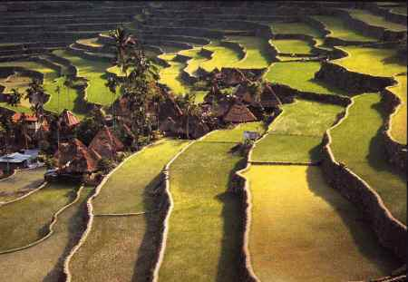
Terracing
Changes one steep hill into a series of small, flat fields
Looks like stairs

Slide 37
Crop Rotation
Farmers plant different crops on the same soil

Slide 38
Cover Crops
Crops that are planted between harvests
Replaces nutrients
Prevents erosion

