Slide 1
Plant Structures

Slide 2
Roots- anchor the plant in soil, take in water, take in nutrients
Leaves-take in carbon dioxide, absorb light from the sun
Stems- provide suppose and structure, allow water and nutrients to travel throughout the plant
Flowers-all the plant to reproduce, bright colors attract insects
Seeds- can grow into new plants, allows the plant to reproduce
Fruit- forms around the seeds, or on the surface, protect the plant, provide nutrients, tempting animals so seeds can be carried away

Slide 3
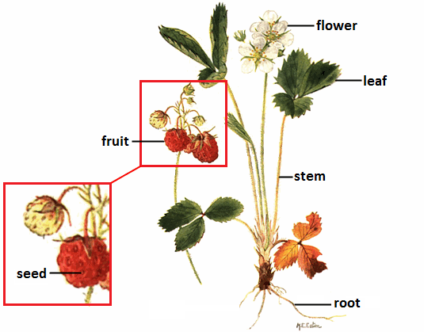

Slide 4
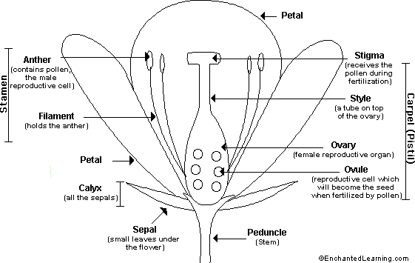
Parts of a Flower

Slide 5
Female Organs (Carpels) | Pistil, ovary, ovules, style, stigma
Male Organs (Stamens) | Anther, filament
Neither | Sepals, stem, petals

Slide 6
Reproductive Structure
in Flowering Plants
Pollen is carried to the stamen, in pollination
A pollen grain goes down the style to the egg in the ovary
The pollen fertilizes the egg and becomes a seed
The ovary develops into a fruit with the seed inside

Slide 7
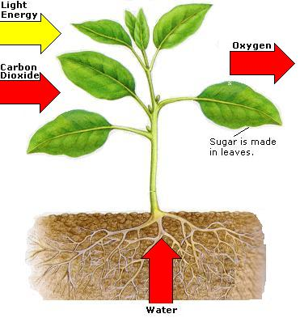
Photosynthesis
Takes place in chloroplasts
The Sun’s energy is used to convert water and carbon dioxide into oxygen and glucose sugar
Takes place only in the light

Slide 8
Cellular Respiration
Oxygen reacts with glucose sugar to produce carbon dioxide, water and energy
Food molecules are broken down
Can take place in the daytime and night

Slide 9
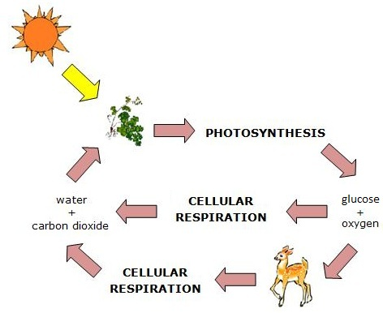

Slide 10
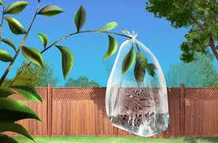
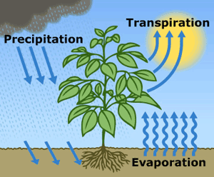
Transpiration
Plants get rid of excess water
Cool themselves in hot conditions
Help in the flow of minerals and nutrients
Keep a healthy moisture balance

Slide 11
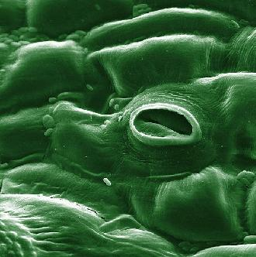
Stomata-special opening on the surface of plant leaves. They open and close to let in carbon dioxide and release water
Guard Cells- border the stomata. Open and close the stomata to regulate the release of water

Slide 12
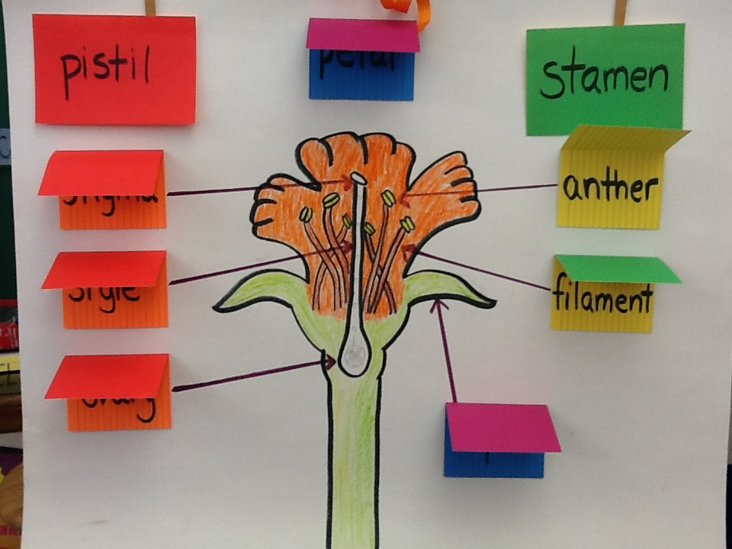

Slide 13
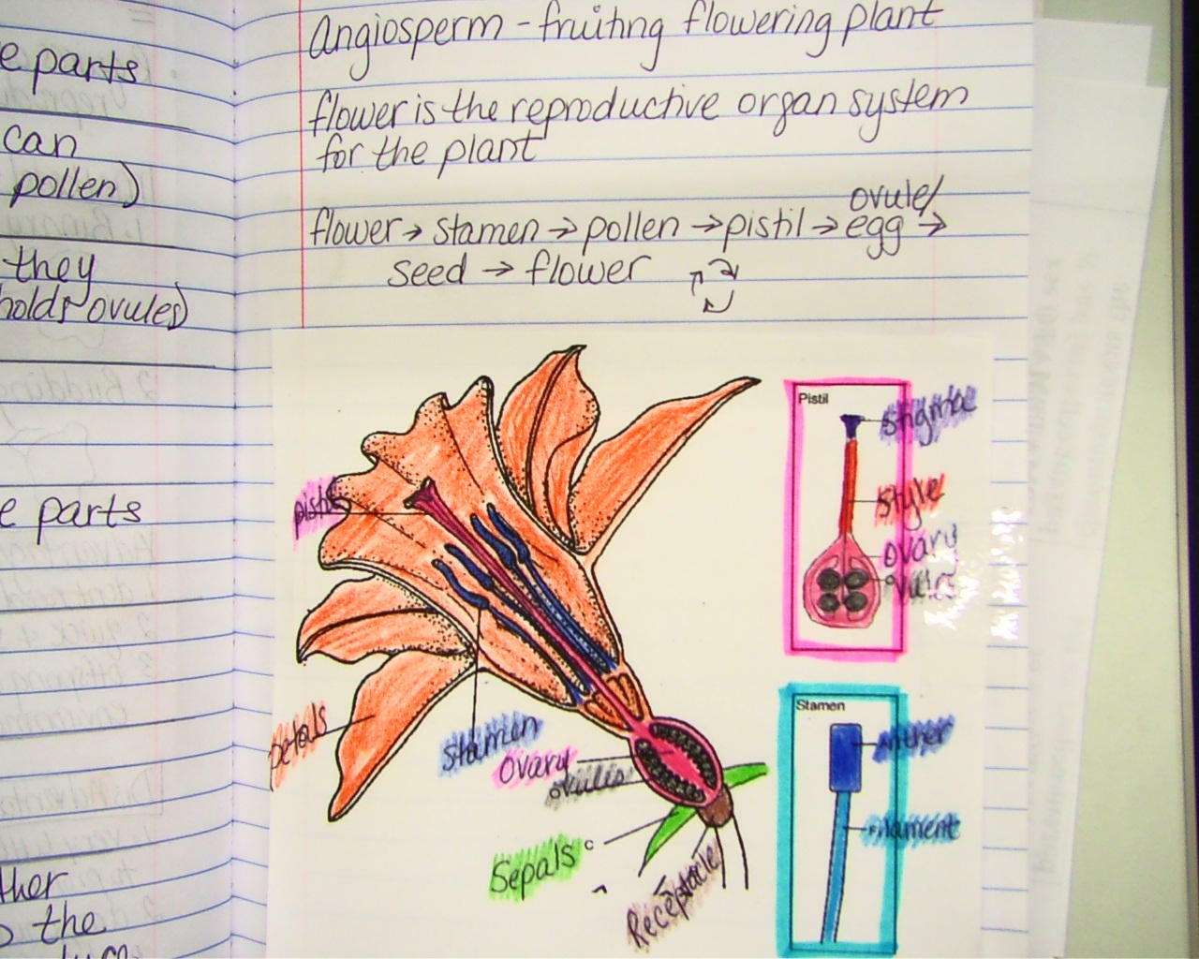

Slide 15
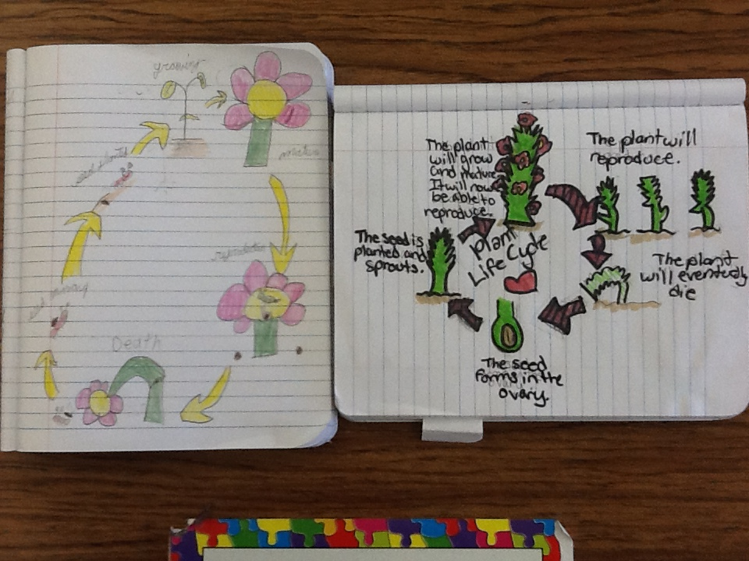

Slide 16
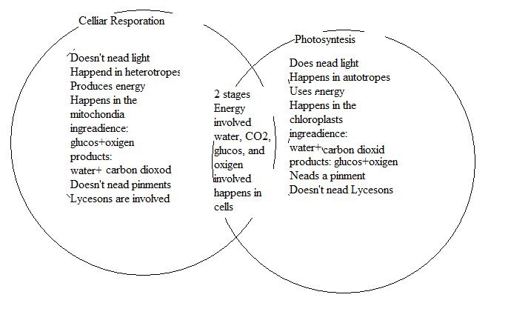

Slide 17
