Slide 1
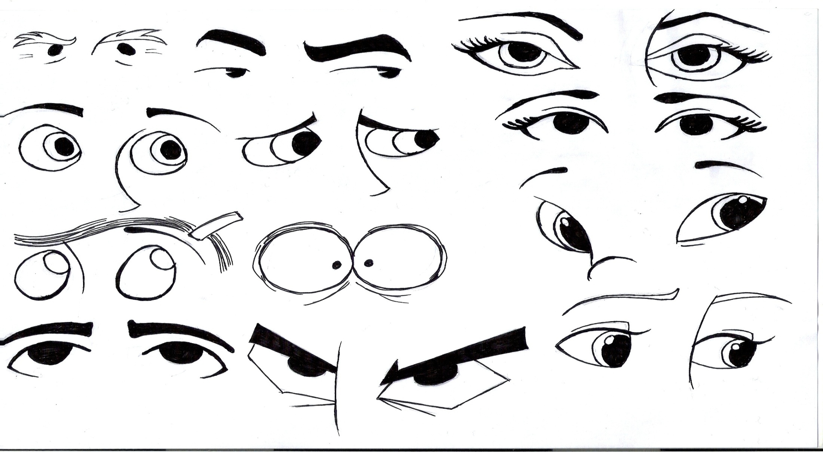
Light and Sight

Slide 2
How You Detect Light
What is visible light?
* The kind of electromagnetic waves that can be detected by your eyes
Rods can detect very
* Dim light
Cones can detect colors in
*bright light

Slide 3
Cornea
*a membrane that protects the eye
5. Pupil
* the opening in the eye
6. Iris
*colored part of the eye
7. Lens
*convex and refracts light to focus a real image on the back of the eye
8. Retina
* Back surface of the eye where light is detected by receptors in the retina called rods and cones

Slide 4
Nerves attached to the ______________ carry information to the brain about the light that strikes the retina.
*rods and cones
10. Nearsightedness happens when a person’s eye is too long, they can see something clearly only if it is ______________. Objects that are far away look ______________________.
*nearby; blurry
11. Farsightedness happens when a person’s eye is too short, they can see ____________ objects clearly, but things that are nearby look ______________.
*faraway; blurry

Slide 5
What do concave lens do?
* Placed in front of a nearsighted eye refracts the light outward. The lens in the eye can then focus the light on the retina.
13. What do convex lens do?
*Placed in front of a farsighted eye focuses the light. The lens in the eye can then focus the light on the retina.

Slide 6
The majority of people who have color deficiency (color blindness) can’t tell the difference between ___________ or can’t tell___________________.
* shades of red and green; red from green
15. Color deficiency cannot be ____________.
*corrected

Slide 7
Surgical eye correction works by reshaping the patient’s __________
*cornea
18. What are the risks of surgical eye correction.
Glares
Double vision
Trouble seeing at night
Lose vision permanently

Slide 8
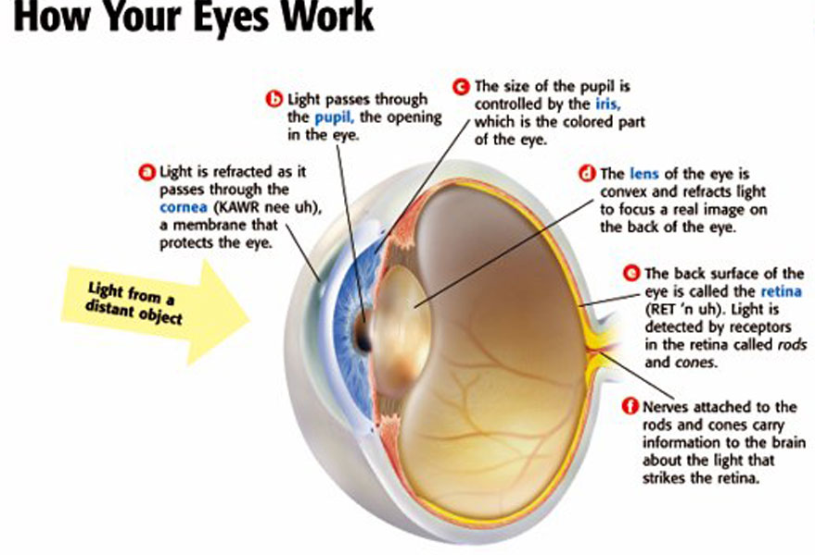
Label the Parts of the Eye

Slide 9
Mr. Parr Eyes Are For Sight http://www.youtube.com/watch?v=xO6gIiuY69g

