Slide 1
-Biotic -Abiotic -Tropism -Limiting Factors

Slide 2
Vocab Preview
Biotic Abiotic Biomes Limiting Factors
Ecosystem Niche Predator Prey
Parasite Host Tropism Phototropism
Geotropism Thermotropism
Hydrotropism Thigmotropism
Have you heard or seen any of these words? Can you figure out what some might mean from their prefixes or suffixes? Take a minute and talk to you neighbor.

Slide 3
Biotic Factors
The living parts of an ecosystem
Lived before, can be dead, can be part of a living thing
Example: plants, animals, fur, etc

Slide 4
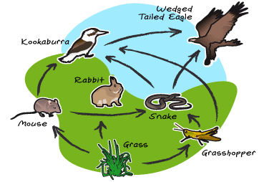
Biotic Factors (copy the examples of Biotic factors)

Slide 5
Abiotic Factors
Non-living parts of an ecosystem
Have never lived, are not dead, are not part of a living thing
Example: rainfall, soil, temperature, sunlight, etc

Slide 6
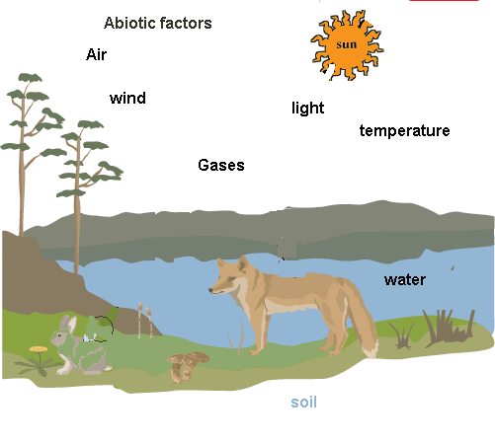
Abiotic factors Copy the examples

Slide 7
The abiotic factors of an ecosystem often determine what living things can live there.
Abiotic factors provide most of the basic needs for plants and animals.
(Do not copy) For example: animals that can survive in the Arctic are adapted to cold climates while animals that can survive in deserts are adapted to dry climates.

Slide 8
Niether Abiotic or Biotic
Man made items because they are not found in natural ecosystems
Abiotic and biotic factors have to be made by nature
Examples: batteries and video games

Slide 9
Biomes
Any type of environment on Earth with a climate and a group of organisms
Examples: Desert, Tundra, Grassland, Savanna, Tropical Rainforest, Marine, Arctic
In any particular environment, the growth and survival of organisms depend on the physical conditions.

Slide 10
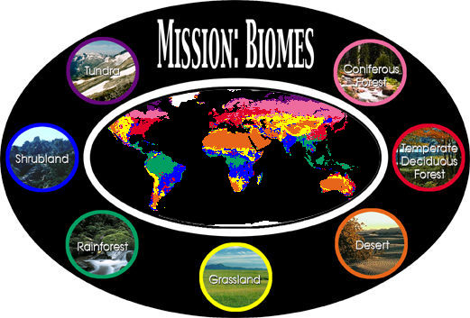
Do not copy

Slide 11
Limiting Factor
Resources that limit a population’s growth. Resources that organisms need to live
Examples: food availability, temperature, water, soil

Slide 12
Example (do not copy)
For a plant population, abiotic limiting factors might be the availability of light or water because plants need these things for photosynthesis. It is possible that too much of something present in the environment is also a limiting factor.
For example, all plants need water in order to survive, but land plants generally cannot live in standing water. The availability of too much water (or nutrients, or intense sunlight) could kill some of the plants in a population, and therefore limit the population size.

Slide 13
Ecosystem- made up of a biotic community and the abiotic factors that affect it
Niche-describes an organism’s lifestyle. Their habitat, climate, and types of food they eat and when they eat.
Predator-an organism that eats all or part of another organism
Prey-an organism that is killed and eaten by another organism
Parasite- an organism that lives in or on a host
Host- living organism that a parasite feeds off

Slide 14
A- not or without
Bio- life
Eco- environment
Geo- land or earth
Photo- light
Thermo- heat
Trop- Turn or rotation
Thigmo-touch

Slide 15
Tropism
A plant’s turning or bending movement toward or away from an external stimulus such as light, heat or gravity
This enhances the survival rate for that plant in a given environment

Slide 16
Phototropism-the growth or bending of a plant toward its light source
Geotropism- the growth response of a plant to the force of gravity
Thermotropism- the ability to respond to the temperature of the environment
Hydrotropism- the growth pattern of a plant in response to water
Thigmotropism- the way a plant grows or bends in response to touch

Slide 17
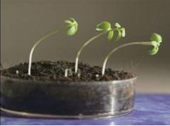
Phototropism (do not copy) These seedlings have bent toward a light source in just a few hours

Slide 18
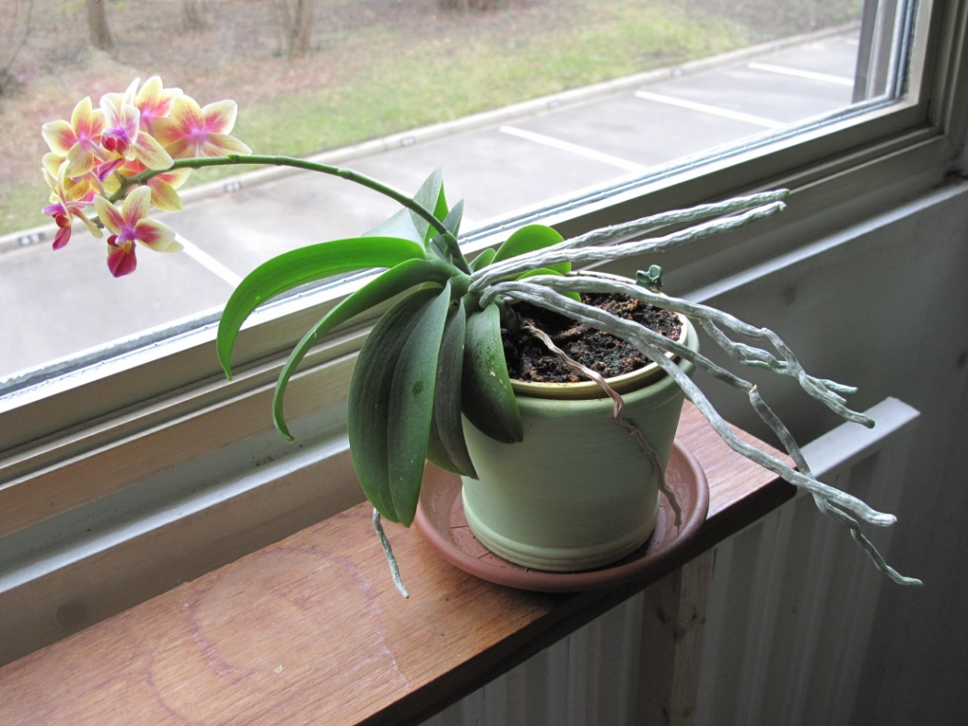
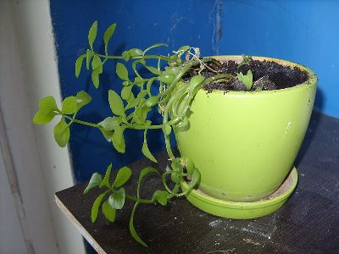
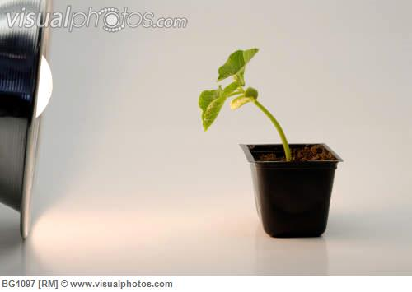
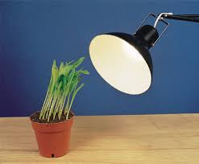

Slide 19
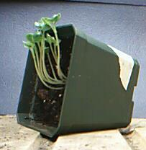
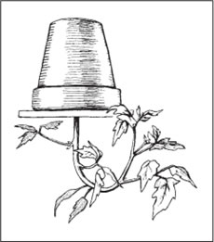
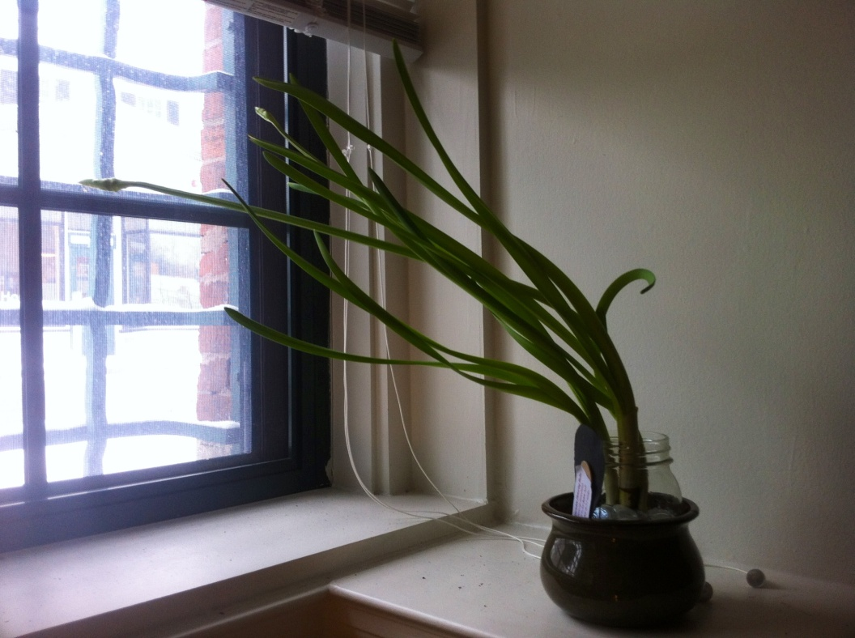

Slide 20
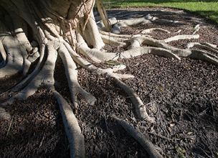
Geotropism (do not copy) Plant roots grow downward Into the soil, while trunks and stems grow upward.

Slide 21
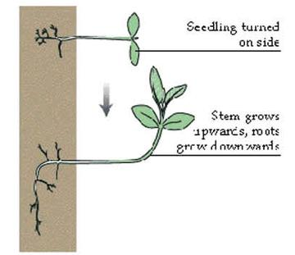
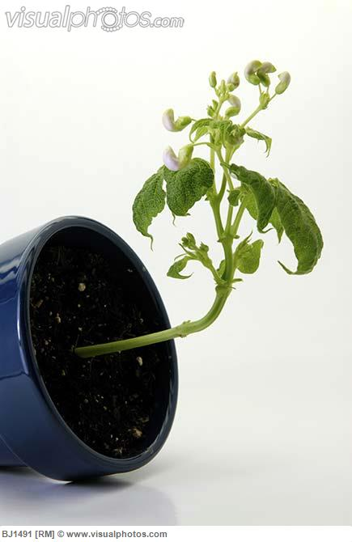
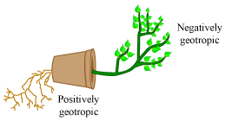

Slide 22
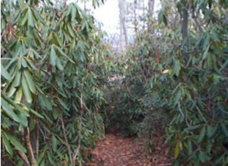
Thermotropism (do not copy) the leaves of this plant on the left are curled and folded down in response to cold temperatures

Slide 23
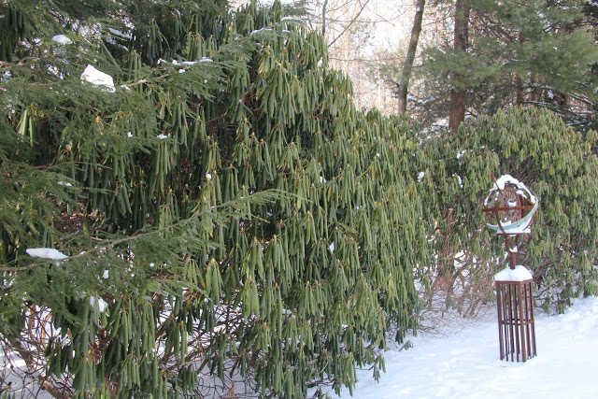
(Do not copy) In the winter, it's large leaves droop down and curl backward so the soft permeable underside is protected, while the outer, waxy side is exposed to the elements.

Slide 24
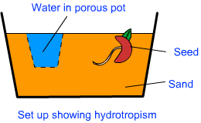
Hydrotropism (do not copy) The root of the pea seedling will curve in search of water

Slide 25
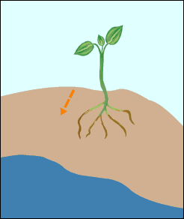

Slide 26
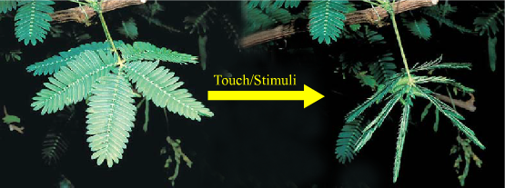
Thigmotropism (do not copy) Thigmotropism is a movement or growth of plant in response to touch or contact stimuli. It is easily visible in plant touch me not (Mimosa pudica) as shown in the diagram.

Slide 27
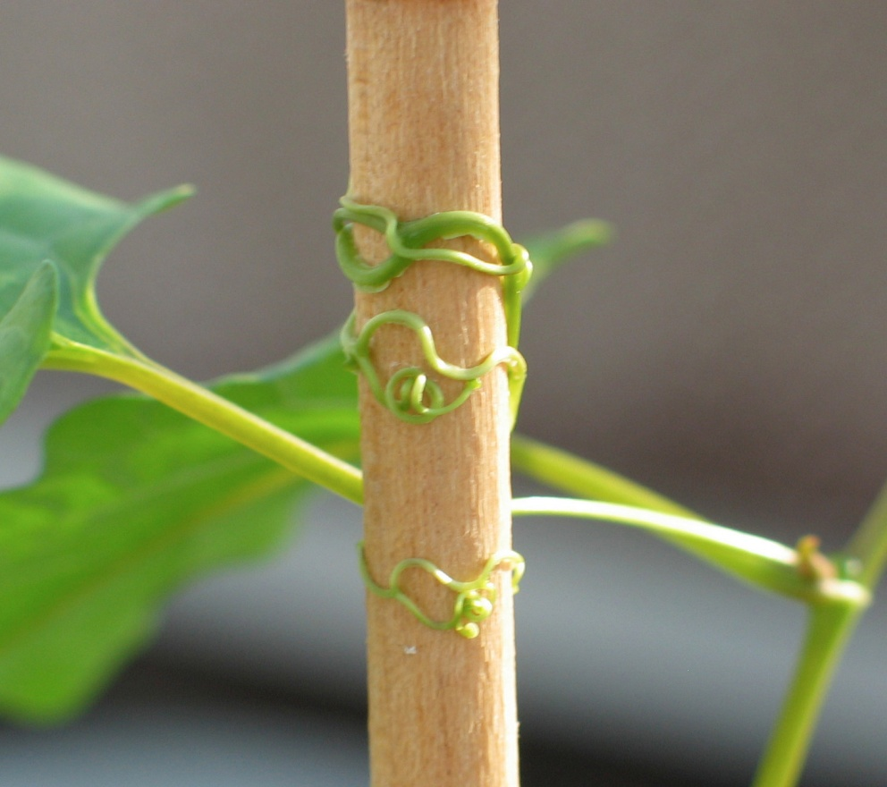
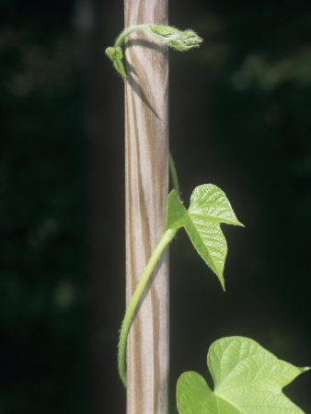

Slide 28
Study Jams: Ecosystem http://studyjams.scholastic.com/studyjams/jams/science/ecosystems/ecosystems.htm
Study Jams: Biomes http://studyjams.scholastic.com/studyjams/jams/science/ecosystems/biomes.htm
Study Jams: Population Growth http://studyjams.scholastic.com/studyjams/jams/science/ecosystems/population-growth.htm
Biomes http://www.youtube.com/watch?v=0A5eeE93uEA

Slide 29
