Slide 1
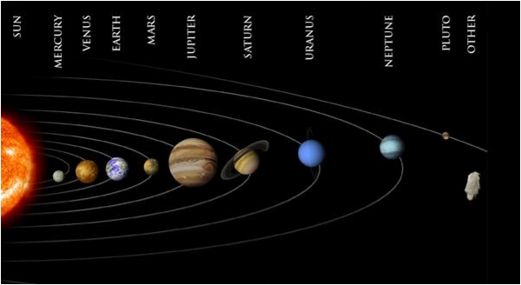
The Solar System

Slide 2
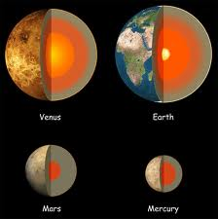
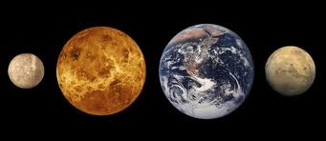
Solar System
Planets- the largest bodies orbiting the sun. Made of mostly rock or gas
Terrestrial Planets- a planet with a dense and rocky surface. Known as INNER PLANETS. (Mercury, Venus, Earth and Mars)
Terrestrial planets orbit the sun in less than 2 years

Slide 3
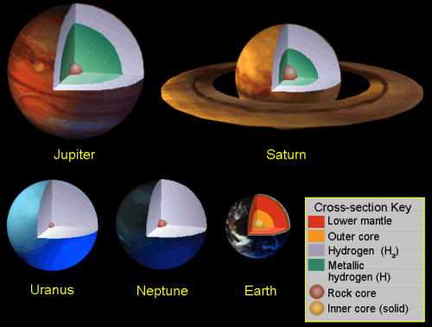
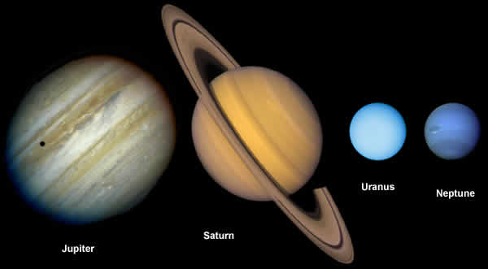
Gas Planets -Extremely cold, large and made of gases. Known as OUTER PLANETS. (Jupiter, Saturn, Uranus, and Neptune)
Gas Planets take 12 to 164 years to fully orbit the sun
Pluto is a dwarf planet
http://www.youtube.com/watch?v=s8eFFnJsCjs

Slide 4
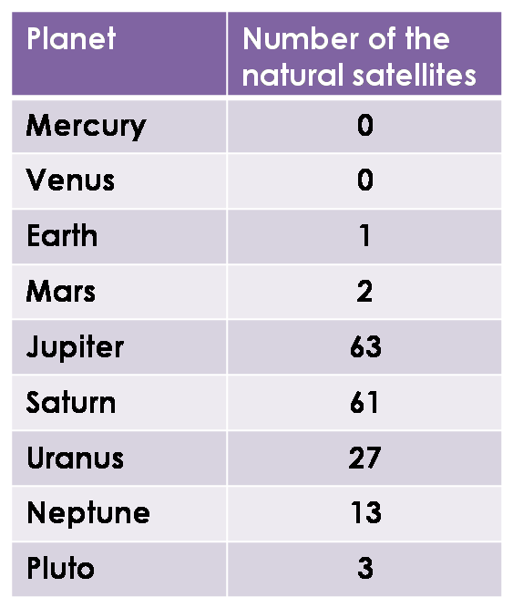
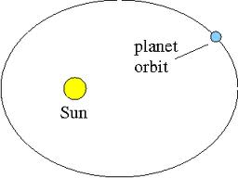
Satellites- natural or artificial bodies that revolve around a planet
The moon is a satellite
All of the Gas Giants have multiple moons
Scientists are still discovering new moons around planets

Slide 6
How is Earth different from other planets?
Three forms of water: solid, liquid, gas
Breathable atmosphere
Has life
Small temperature range
Can use sun light as energy
Our atmosphere provides protection from harmful radiation and solar winds
Ozone layer- blocks much of the Sun’s UV radiation and prevents it from damaging the cells of living organisms

Slide 7
Bill Nye Demonstrates Distance Between Planets
http://www.youtube.com/watch?v=97Ob0xR0Ut8
Bill Nye: 95 Comets and Meteors
http://www.youtube.com/watch?v=UQpL8JXOqrs
Planets Around a Star Song
http://www.youtube.com/watch?v=nQfJ7j2UGGk

Slide 8
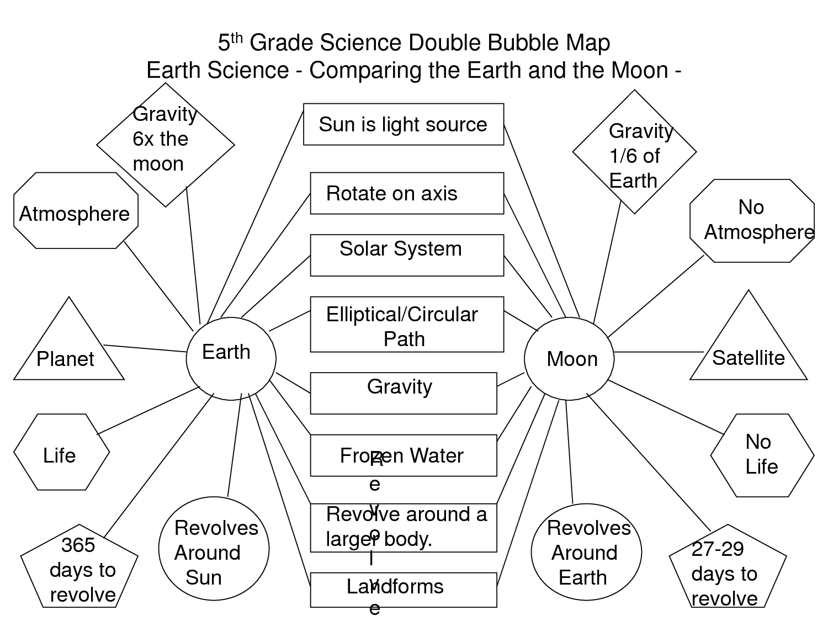

Slide 9
Your
Planet
Earth

