Slide 1
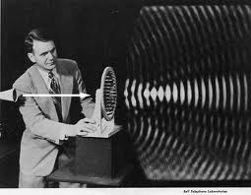
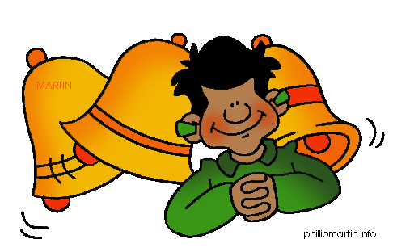
Sound

Slide 2
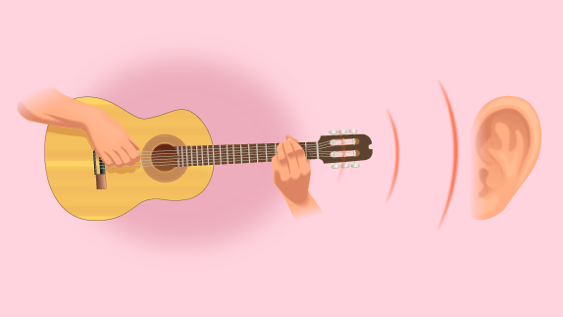
Sound is produced by vibrations
Vibration: the complete back and forth motion of an object or material
Example:
Guitar Strings Vibrate
Air Vibrates
Ear Drum Vibrates
SOUND

Slide 3
Sound Waves
A sound wave is a longitudinal wave generated by a vibrating material.
It is then carried through a medium and transfers energy.
Sound waves travel in all directions away from their source
Sound has to have a medium
Sound can not travel in a vacuum

Slide 4
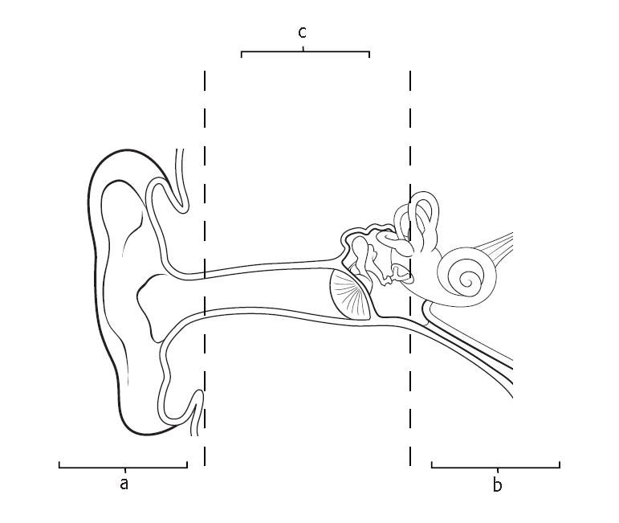
Middle Ear
Three bones (hammer, anvil, stirrup)-act as levers to increase the size of the vibration
Inner Ear
Turns vibrations into signals for the brain
Outer Ear
collects sounds

Slide 5
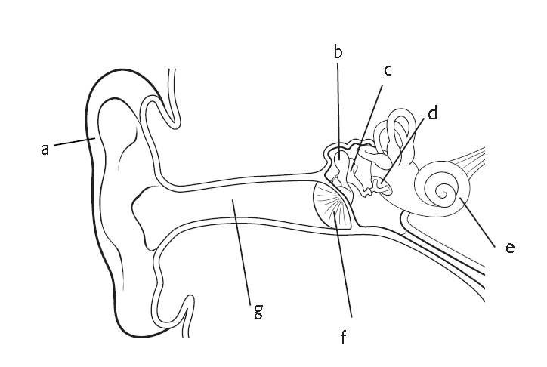
Hammer
Anvil
Stirrup
Pinna
Cochlea
Ear Canal
Ear Drum

Slide 6
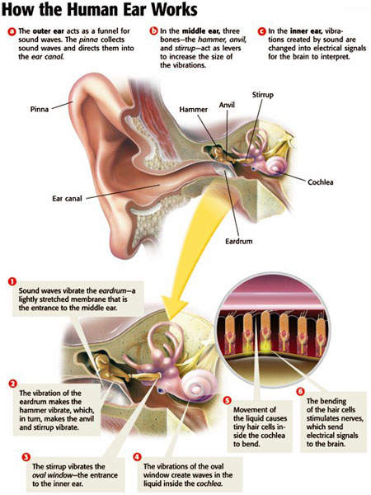
Page 471-Do not copy in notes

Slide 7
Humans produce the sounds necessary for speech by using their vocal cords.
Sound is produced when air from the lungs past the vocal cords, causing them to vibrate.

Slide 8
The speed of sound represents how far a sound wave travels in a given amount of time
Fastest in Solids
Slowest in gases
The hotter the temperature-the faster the wave travels
The colder the temperature-the slower the wave travels

Slide 9
Pitch- how high or low a sound is
Loudness- how well the sound can be heard
Decibel- measures loudness
Decibel Level | Sound
0 | Softest sound you can hear
20 | Whisper
25 | Purring Cat
140 | Jet engine 30 meters away
200 | Rocket engine 50 meters away

Slide 10
Parts of the Ear
Outer Ear- collects sound waves and directs them into the ear canal
Middle Ear- the three bones act as levers to increase the size of vibration
Inner Ear- converts vibrations into electrical signals for the brain to interpret

Slide 11
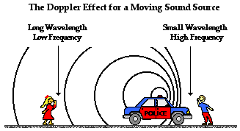
Doppler Effect
Doppler Effect is the change in frequency of a sound caused by the motion of the listener or source of the sound

Slide 12
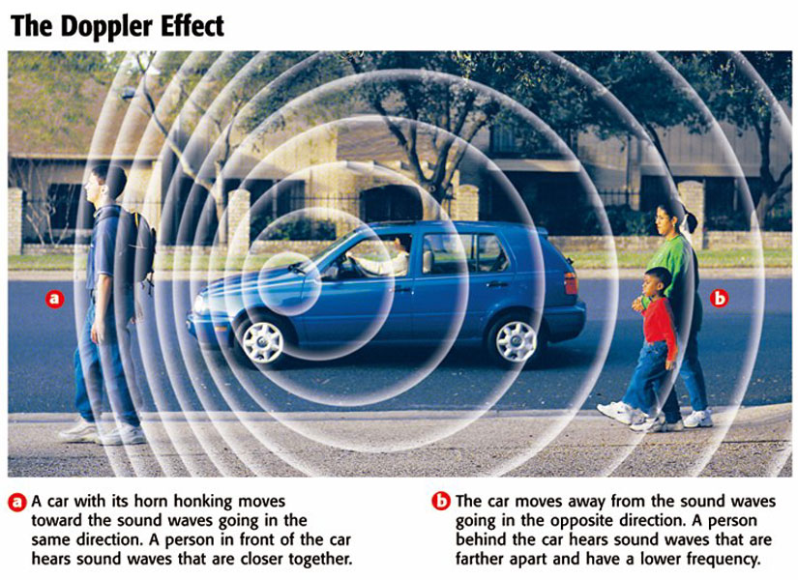
Do not copy in notes Page 476

Slide 13
Hearing Problems
Damage to the cochlea or any part of the inner ear usually results in permanent hearing loss.
Tinnitus- caused by long term exposure to loud sound

Slide 14
Protect Your Hearing
Use ear plugs
Use a lower volume
Move away from loud sounds

Slide 15
Copy the Vocab Word and Draw the picture in your notes

Slide 16
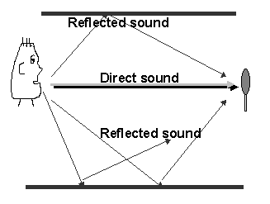
Do not copy in notes

Slide 17
Copy the Vocab Word and Draw the picture in your notes

Slide 18
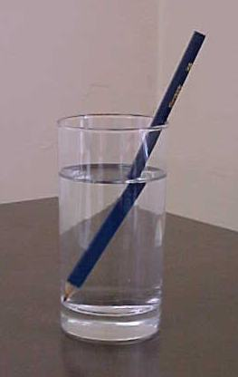
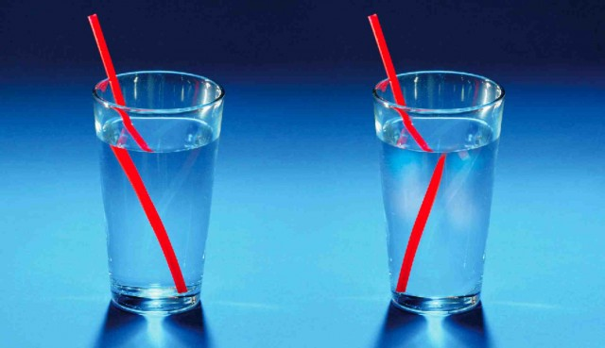
Do not copy in notes

Slide 19
Copy the Vocab Word and Draw the picture in your notes

Slide 20
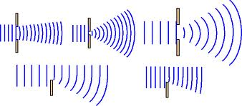
Do not copy in notes

Slide 21
Copy the Vocab Word and Draw the picture in your notes

Slide 22
Do not View these videos until you are done with all of your work.
Study Jams Senses: Hearing: http://studyjams.scholastic.com/studyjams/jams/science/human-body/hearing.htm
Study Jams: Sound: http://studyjams.scholastic.com/studyjams/jams/science/energy-light-sound/sound.htm
How the Ear Works http://www.sciencekids.co.nz/videos/humanbody/ear.html
Study Jams Clip http://www.youtube.com/watch?v=CSO765hyxrc
Study Jams Full Hearing Clip http://studyjams.scholastic.com/studyjams/jams/science/human-body/hearing.htm

