Slide 1
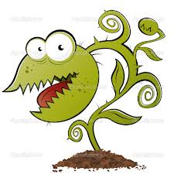
Plant Defense
Resource: http://www.morning-earth.org/Graphic-E/BIOSPHERE/Bios-C-PlantsDefense.html

Slide 2
Plant Defense
Plants are tough survivors. They have successfully defended themselves against attack for hundreds of millions of years.

Slide 3
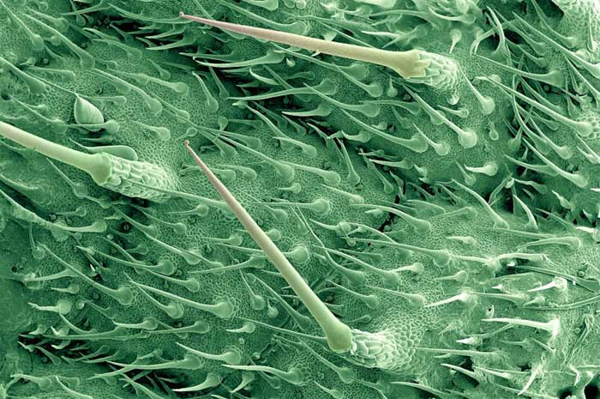
Thorns, Spines, and Micro-Needles
Used to discourage grazers

Slide 4
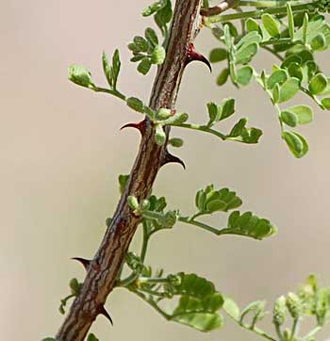
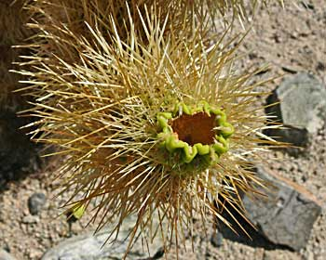
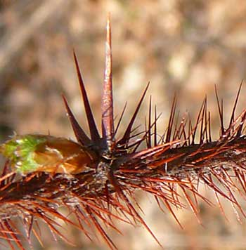
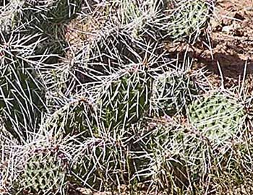
Cat’s Claw
Cholla Cactus spines
Gooseberry Spine Leaves
Prickly Pear Cactus

Slide 5
Barriers: cuticle, bark and resin
Woody plants have bark
Herbs have waxy cuticles
Both are barriers that resist penetration by virus particles, bacteria, and spores of fungi
Some bark grows to 1 foot thick to resist fire
Resin (sap)

Slide 6
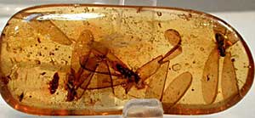
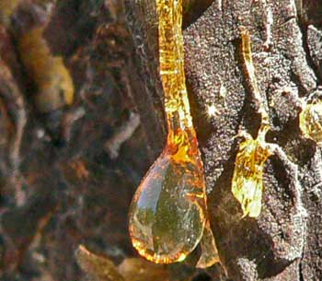

Slide 7
Plant Poisons
Leaves a bad taste
Interfere with digestion
Interfere with nervous system
Can cause death

Slide 8
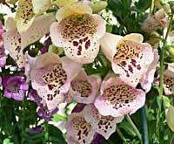
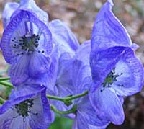
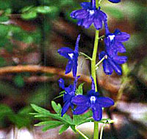
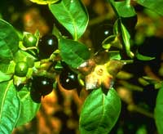
Plant Poisons
Monkshood
(called Wolfsbane) in werewolf movies
Foxglove (Witches’ Glove or Dead Man’s Bells)
Tall Larkspur
Deadly Nightshade

Slide 9
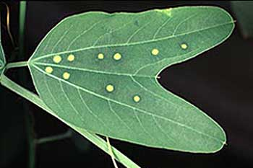
Mimicry
Plants mimic the presence of insect eggs on their leaves to discourage insects from laying their eggs there.

